Slide 1
PROJECT PRESENTATION Motor Current Safety Monitoring System Presented by: GROUP 1.8 Department: Electrical and Electronic Engineering Course: BEE208 – Introduction to Computer Programming Institution: Accra Technical University

Slide 2
Introduction Electric motors are widely used in industries, homes, and commercial facilities. One of the major causes of motor failure is overloading, where the motor draws more current than it is designed to handle. This project was developed to monitor motor current by comparing the rated current with the measured current and informing the user whether the motor is operating safely or is overloaded.

Slide 3
Problem Statement
Monitoring motor current manually can be difficult and time-consuming.
If a motor operates above its rated current for a long period:
It overheats.
It loses efficiency.
It may become permanently damaged.
It increases maintenance costs.
Therefore, a simple monitoring system is needed to detect overload conditions quickly.

Slide 4
Aim
To develop a Motor Current Safety Monitoring System that checks the operating condition of electric motors by comparing rated current with measured current.

Slide 5
Objectives
Develop a menu-driven C++ application.
Accept motor information from the user.
Compare rated current with measured current.
Determine whether the motor is safe or overloaded.
Display monitoring reports.
Save reports into a text file.
View saved reports.
Clear saved reports.

Slide 6
Programming Concepts Used
C++ Concepts Used
Classes and Objects
Header Files
Source Files
Functions
if...else Statements
switch Statements
for Loop
do...while Loop
continue Statement
break Statement
File Handling
String Manipulation

Slide 7
System Flow
Explain:
User starts the program.
Menu is displayed.
User selects an option.
Motor information is entered.
System validates the input.
Current comparison is performed.
Safety status is displayed.
Report is saved.
User returns to the menu or exits.

Slide 8
How the System Works
Example:
Rated Current = 10 A
Measured Current = 8 A
Since:
8 ≤ 10
Status:
✅ Safe Operation

Slide 9
Program Features
The system can:
Monitor multiple motors
Validate user input
Detect overload conditions
Display motor reports
Save reports
View reports
Clear reports
Display system information

Slide 10
Sample Output
Include screenshots of:
Main Menu
Motor Report
Saved Report

Slide 11
Challenges Encountered Examples: Understanding file handling. Managing user input correctly. Handling invalid menu selections. Reading and writing reports. Organizing the program using classes.

Slide 12
Lessons Learned Through this project I learned: Object-Oriented Programming File Handling Menu-Driven Programming Input Validation Debugging Website Development using HTML, CSS, and JavaScript Basic Software Development Process

Slide 13
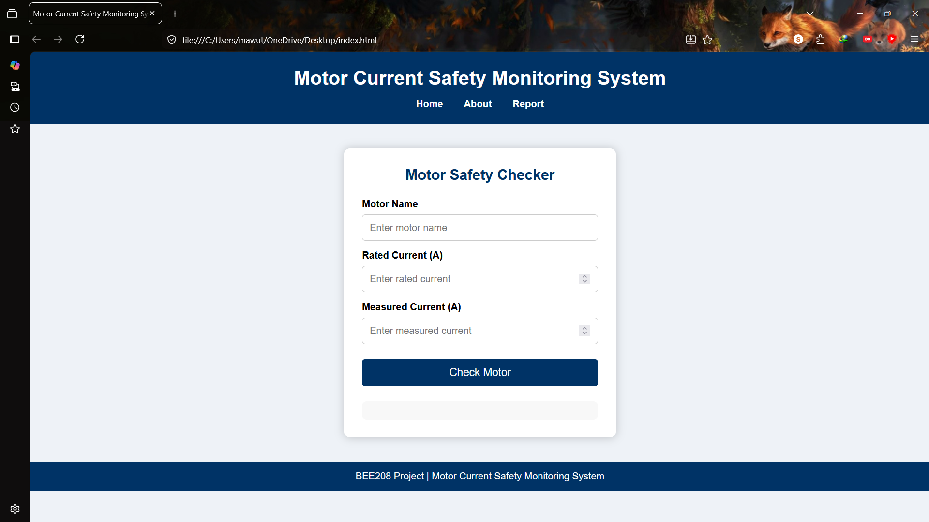
Website
Home page Motor Safety Checker About page Report page Mention that the website provides a simple graphical interface that demonstrates the same motor current comparison concept as the C++ application.

Slide 14
Conclusion The Motor Current Safety Monitoring System successfully compares rated current with measured current to determine whether a motor is operating safely or is overloaded. The project demonstrates the practical application of C++ programming concepts while solving a real engineering problem. It also includes a companion website to improve accessibility and demonstrate the system through a user-friendly interface.

Slide 15
Thank You!!

Slide 16
GROUP MEMBERS

